Slide 1
Team Ink3D Test Plan Review
Daniel Lain
Tim Edmonson
Shawn Simonson
Jesse Bowles

Slide 2
Outline
Requirements Overview
Architecture Overview
Detail Design Overview
Test Items
Risks
Features To Be Tested
Features Not Tested
Test Deliverables
Test Schedule

Slide 3
Critical Requirements
3.1 STL File Input
3.3 Generate Machine Instructions
3.4 Issue Machine Instructions
3.5 Monitor Temperature
3.6 Monitor Position
3.7 Adhere to Material Constraints
3.8 Identify Materials
3.9 Identify Shapes
3.10 Determine Shape of Support Material Structure
3.11 Create Printing Path
3.12 Database Interface
3.13 Store & Load Material Records
3.14 Slice Geometry into Thickness Levels
3.15 Monitor Flow Sensors
3.17 Allow for UV Head Polymerization
4.1 Software Installer
4.2 Host Software to Printer Connection
6.1 Temperature Cutoff Threshold
6.2 Printing Area Restrictions
8.1 Material Database
8.2 Abstract Hardware Interface
8.3 Modular and Scalable Design

Slide 4
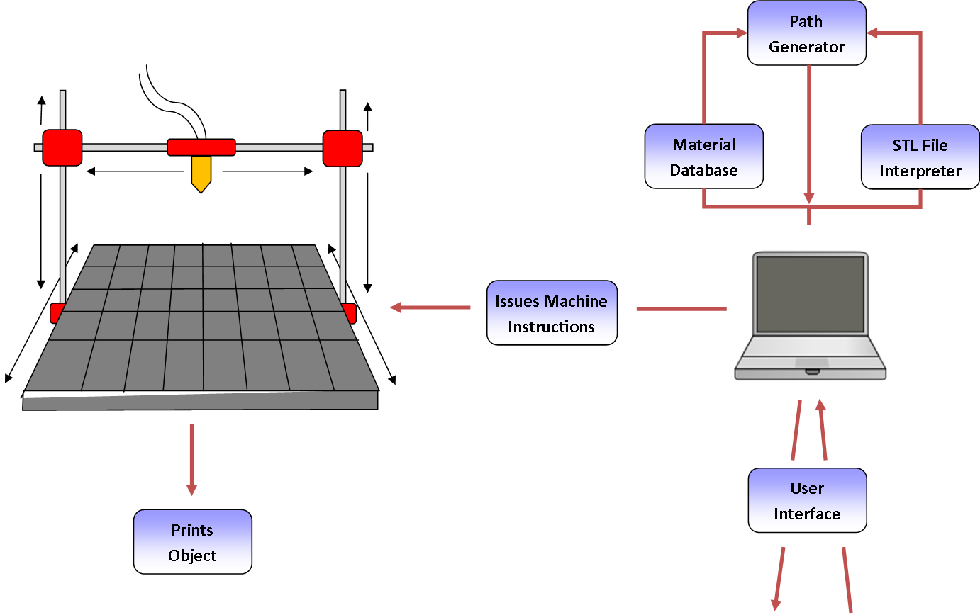
Architecture Overview
Configurability
Modularity
Expandability
Portability
Multiple Materials

Slide 5
Architecture Design
Seven Layers
Layer Independence
Interface Based
Master Configuration Object

Slide 6
Module Decomposition
High Cohesion
Low Coupling
Master Configuration Object

Slide 7
Module Data Flows
Layer | Data Flow ID | Data
Outside Inputs | OI1 | Object file of the STL file to be printed
 | OI2 | Printer configuration data entry values
 | OI3 | Material configuration data entry values
 | OI4 | Print configuration data entry values
 | OI5 | Print selections and button press
 | OI6 | Pause, resume, and stop button Presses
 | OI7 | Disk reads of XML and Directory structure
 | OI8 | Printer state information
 | OI9 | OS Driver information
 | OI10 | Extruder configuration data entry values
User Interface Layer | UI1 | Import file name
 | UI2 | Success state of import
 | UI3 | Loaded printer configuration
 | UI4 | Save printer configuration request
 | UI5 | Save material configuration request
 | UI6 | Loaded material configuration
 | UI7 | Loaded print configuration
 | UI8 | Save print configuration request
 | UI9 | Loaded configuration data
 | UI10 | Run print job
 | UI11 | Pause, resume, and stop button Presses
 | UI12 | Printer state information
 | UI13 | File Configuration object
 | UI14 | Printer configuration object
 | UI15 | Material configuration object
 | UI16 | Print Configuration object
 | UI17 | All requested configuration objects
 | UI18 | Object save/load requests
 | UI19 | Object save/load results
 | UI20 | XML File writes to disk
 | UI21 | Save print job configuration
 | UI22 | Print package object
 | UI23 | Print, Pause, Resume request
 | UI24 | Loaded Extruder Configuration Data
 | UI25 | Save Extruder Configuration Request
 | UI26 | Extruder Configuration Object
Preprocessing Layer | PR1 | Print package object
 | PR2 | Print package object
Processing Layer | PO1 | Print package object
Post-Processing Layer | PP1 | Print package object
 | PP2 | Print package object
Printer Control Layer | PL1 | G-Code
Communications Layer | CL1 | Serialized G-Codes
 | CL2 | Serialized printer state
 | CL3 | Command stream
Printer Feedback Layer | PF1 | Printer State Object
 | PF2 | Printer State Object
Many GUI Exchanges
Very Little In Processing

Slide 8
Staged Development
Stage one
User Interface Layer
Database subsystem
Persistence Framework
Command Structure
Preprocessing Layer
Normalization Subsystem
Object Subsection Module
Object Translation Module
Processing Layer
Slicing Engine
Slicing Engine Wrapper
Post Processing Layer
G-Code Preparation
Parser Module
Unification Module
Communications Layer
Communications Subsystem
Serialization Module
TxRx Module
Deserialization Module

Slide 9
Staged Development
Stage Two
User Interface Layer
GUI Subsystem
Print Job GUI Module
Controller Subsystem
Print Job Controller
Printer Control Layer
Printer State Controller
Printer State Controller
Stage Three
User Interface Layer
GUI Subsystem
Import GUI Module
Printer Configuration GUI Module
Material GUI Module
Print Configuration GUI Module
Extruder GUI Module
Status GUI Module
Controller Subsystem
Import Controller
Printer Configuration Controller
Material Controller
Print Configuration Controller
Extruder Controller
Printer Feedback Layer
State Monitoring
Dispatch Module

Slide 10
Staged Development
Stage Three
User Interface Layer
GUI Subsystem
Import GUI Module
Printer Configuration GUI Module
Material GUI Module
Print Configuration GUI Module
Extruder GUI Module
Status GUI Module
Controller Subsystem
Import Controller
Printer Configuration Controller
Material Controller
Print Configuration Controller
Extruder Controller
Printer Feedback Layer
State Monitoring
Dispatch Module

Slide 11
Design Decomposition

Slide 12
User Interface Unit Testing
Command Structure Module and Persistence Framework
Test ID | Input | Expected Output/Action | Test
CS1 | Function Call | Multiple Array Lists of file names | Execute get Configurations and ensure all files are listed for each type of object in storage
CS2 | Function Call String | Fully formed Configuration Object | Call get config function with file name
CS7 | Function Call Configuration Object | Boolean True | Call save configuration function with file name
CS11 | Function Call String | Boolean True | Call delete configuration function with file name

Slide 13
GUI Unit Testing
Goal:
Test GUI and data types
Import GUI
Test ID | Input | Expected Output/Action | Test
IG1 | Button Press String File Name | Returns message of success to user. Returns message of failure to user. Returns message of failure to user. | Choose a valid STL file and click Import. Choose an invalid STL file and click Import. Choose an invalid file type and click “Import”.
IG2 | Button Press String File Name | Returns message of success to user. | Choose an STL file and click “Delete”.

Slide 14
GUI Unit Testing
Material, Print, Printer, & Extruder
Status
Test ID | Input | Expected Output/Action | Test
XX1 | Button Press String File Name | Updates display | Manually click “New”.
XX2 | Button Press String File Name | Returns message of success to user. Returns message of failure to user. | Insert data of valid type and click “Save”. Insert data of invalid type and click “Save”.
XX3 | Button Press String File Name | Returns message of success to user. | Choose a printer config file and click “Delete”.
Test ID | Input | Expected Output/Action | Test
GS1 | Button Press | Updates display Updates display | Click “pause” button Click “resume” button
GS2 | Button Press | Updates display | Click “Cancel” button.

Slide 15
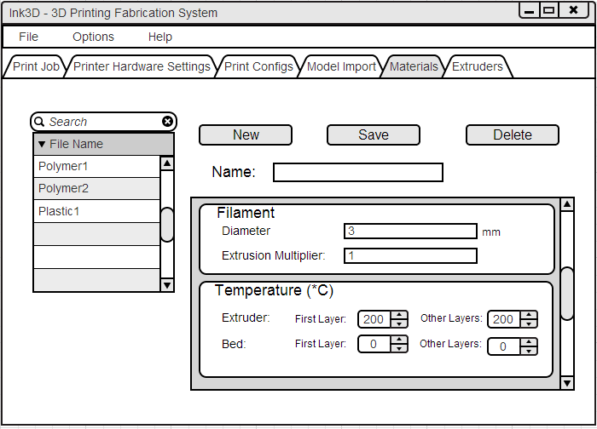
GUI Unit Testing
XX1 - Input
Output:
Display is Cleared

Slide 16
GUI Unit Testing
XX2 - Input
Output:
Notification Message

Slide 17
GUI Unit Testing
XX3 - Input
Output:
Notification Message

Slide 18
GUI Unit Testing
XX1 - Input
XX2 - Input
XX3 - Input

Slide 19
GUI Unit Testing
Print Job
Test ID | Input | Expected Output/Action | Test
GP1 | Button Press String File Name | Updates display | Choose a print job configuration.
GP2 | Button Press | Updates display | Click “New Subsection”.
GP3 | Button Press String File Name Print Job Config Data | Returns message of success to user. Returns message of failure to user. | Insert data of valid type and click “Save”. Insert data of invalid type and click “Save”.
GP4 | Button Press String File Name Print Job Config Data | Returns message of success to user. | Choose a print job file and click “Delete”.

Slide 20
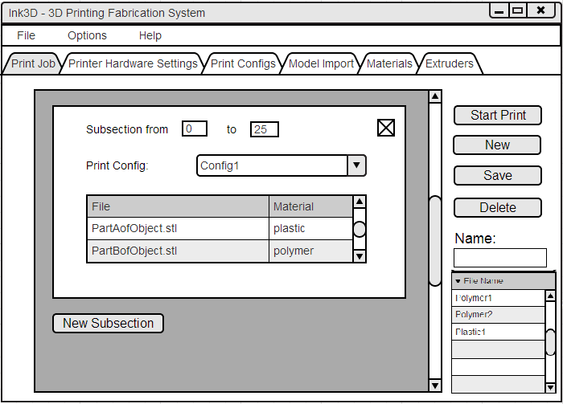
GUI Unit Testing
GP1 - Input
Output: Cleared Fields

Slide 21
GUI Unit Testing
GP2 - Input
Output: Updated Display

Slide 22
GUI Unit Testing
GP3 - Input
Output: Confirmation Message

Slide 23
GUI Unit Testing
GP4 - Input
Output: Confirmation Message

Slide 24
GUI Unit Testing
GP1 - Input
GP3 - Input
GP4 - Input
GP2 - Input

Slide 25
Controller Unit Testing
Goal:
Test function calls and data boundaries
Import
Test ID | Input | Expected Output/Action | Test
IC1 | File Name of STL | Boolean Success state = success Boolean Success state = failure Boolean Success state = failure | Pass a valid STL file to import() Pass an invalid STL file to import() Pass an invalid file type to import()
IC2 | File Name of STL | Boolean Success State = success Boolean Success State = failure | Pass a valid STL file to delete() Pass an invalid file to delete()

Slide 26
Controller Unit Testing
Material, Print, Printer, & Extruder
Test ID | Input | Expected Output/Action | Test
XX1 | String File Name XXX Config Object | Boolean Success State = success Boolean Success State = failure | Pass a XXX Config object with values within boundary tosave() Pass a XXX Config object with values exceeding boundary to save()
XX2 | String File Name | XXX Config Object Error | Pass valid string name to load() Pass invalid string name to load()
XX3 | String File Name | Boolean Success State = success Boolean Success State = failure | Pass valid string name to delete() Pass invalid string name to delete()
XX4 | None | Array List<String> of file names | Call loadAvailableXXXConfigs()

Slide 27
UI Component Testing
GUI
Controller
Test ID | Input | Expected Output/Action | Test
GS1 | Button Presses Text Fields | Updates display with correct results Navigating between menus is easy. (This output is subjective) | Test individual units Tester navigates the menus by clicking the tabs.
Test ID | Input | Expected Output/Action | Test
GC1 | String File Names Object Files | Makes the proper load and save requests with the correct info. | Check how the subsystem handles correct and incorrect data.

Slide 28
Preprocessing Unit Testing
Subsection Module
Test ID | Input | Expected Output/Action | Test
SM1 | Start Z End Z Parent STL for each material Per subsection. | STL files for each material in each subsection all bound by their specified Start Z and End Z. | Manually build a PrintJobConfiguration object with the described input and pass it to the Subsection Module. Observe the output STL files for correctness.
File Translation Module
Test ID | Input | Expected Output/Action | Test
FT1 | Subsection STL files for each subsection Material Configurations for each material in each subsection | AMF file for each subsection that describes the combination of all subsection STL files as a combination of volumes, each volume mapped to its correct material. | Manually build a PrintJobConfiguration object with the described input and pass it to the File Translation Module. Observe the output AMF file for correctness.

Slide 29
Processing Unit Testing
Slicing Engine Wrapper Module
Test ID | Input | Expected Output/Action | Test
SE1 | All data items described in the Detailed Design Specification section 6.1.1.4 | G-Code files for each subsection. | Manually build a PrintJobConfiguration object with the described input and pass it to the Slicing Engine Wrapper Module. Observe the output G-Code files for correctness.

Slide 30
Post Processing Unit Testing
Parser Module
Test ID | Input | Expected Output/Action | Test
PM1 | The printer G-Code flavor Printer custom start G-Code Printer custom end G-Code, and G-Code files for each subsection. | G-Code files for each subsection with only G-Code commands specific to the specified printer G-Code flavor, the printer customer start G-Code on the bottom most layer, and the printer custom end G-Code at the end of the top most layer. | Manually build a PrintJobConfiguration object with the described input and pass it to the Parser Module. Observe the output G-Code files for correctness.
Unification Module
Test ID | Input | Expected Output/Action | Test
UM1 | G-Code files for each subsection. | Finalized G-Code file with all subsection G-Code in the order from the bottom most subsection to the top most subsection. | Manually build a PrintJobConfiguration object with the described input and pass it to the Unification Module. Observe the output G-Code file for correctness.

Slide 31
Preprocessing Component Testing
Normalization Subsystem
Test ID | Input | Expected Output/Action | Test
NS1 | Start Z End Z for each subsection Parent STL File for each material in each subsection. | AMF file for each subsection that describes the combination of all subsection STL files as a combination of volumes, each volume mapped to its correct material. | Manually build a PrintJobConfiguration object with the described input and pass it to the Normalization Subsystem. Observe the output AMF file for correctness.

Slide 32
Post Processing Component Testing
G-Code Preparation Subsystem
Test ID | Input | Expected Output/Action | Test
GP1 | The printer G-Code flavor Printer custom start G-Code Printer custom end G-Code G-Code files for each subsection. | Finalized G-Code file with all subsection G-Code in the order from the bottom most subsection to the top most subsection. | Manually build a PrintJobConfiguration object with the described input and pass it to the G-Code Preparation Subsystem. Observe the output G-Code file for correctness.

Slide 33
Printer State Controller – Unit Tests
PS1 | G-Codes User Interface Status (Cancel) | The Printer State Controller shall halt the sending of G-Codes to the Serialization Module. | Manually build PrintJobConfiguration object with test G-Codes. Trigger cancel event to ensure that no further G-Codes are sent to Serialization Module. There is no return state. Therefore, the print job cannot be resumed.
PS3 | G-Codes and User Interface Status (Pause/Resume) | The Printer State Controller shall halt the sending of G-Codes to the Serialization Module until resume action is received. | Manually build PrintJobConfiguration object with test G-Codes. Trigger pause event to ensure that no further G-Codes are sent to Serialization Module. Trigger resume event to ensure that G-Codes resume transmission from prior state.
PS1 and PS3 ensure that G-Code stream is correctly acted upon in response to user input.
Outbound G-Codes will be written to log and compared against incoming G-Codes.
When the user cancels or pause/resumes print job in the UI menu, the PSC (Printer State Controller) will perform an action. This action will be reflected in the outbound G-Codes which can be compared to the inbound G-Codes for correctness.

Slide 34
Printer State Controller
PS2 | G-Codes Printer Feedback Status (Temperature and Position) | The Printer State Controller shall consume temperature and position information from Printer Feedback Status and insert halt command into the G-Code buffer to stop the print when values are out of range. | Manually build PrintJobConfiguration object with test G-Codes. Manually build Printer State Object with out-of-bounds operating parameters. Ensure that proper halt G-Codes are inserted into the output G-Code buffer.
PS2 ensures that the G-Code stream is correctly acted upon in response to printer feedback (temperature, arm position)
Verified in the same manner that PS1 and PS3 are verified.
The exception is that the action is based on printer feedback and not user input.

Slide 35
Dispatch Module – Unit Tests
DM1 | De-Serialized printer feedback information | Populated PrinterFeedback object | Build de-serialized printer feedback object which represents the de-serialized printer feedback data. Verify that the PrinterFeedback Object is built correctly by the Dispatch Module.
Manual test involves building test printer feedback data.
We will feed mock positions and temperatures to dispatch module
To Verify, we check that the PrinterFeedback Object is correctly built by displaying or logging the contents of the PrinterFeedback Object

Slide 36
Serialization Module – Unit Test
SE1 | Finalized G-Codes | Serialized stream of G-Codes to be sent to the printer | Manually build simple G-Code set to be tested. Inspect and verify that Serialization Module serializes G-Codes without serialization errors.
The Serialization Module will be passed a test set of G-Codes
The Serialization Module will serialize the G-Codes and print the serialized results to a log
The log can be manually inspected for serialization errors (out of order or missing data for example).

Slide 37
Deserialization Module – Unit Test
DS1 | Serialized byte-stream of printer feedback information | De-Serialized printer feedback object | Build test program that establishes connection to the printer and issues simple G-Codes. Connect test PC to printer and monitor feedback stream from printer. Inspect and verify that the de-serialized printer feedback object is built correctly. Inspection and verification can be accomplished with a Java debugger hooked into the test program.
The Deserialization Module can be tested in real time.
Can set break condition in Java debugger such that we can step into the debugger when printer feedback has been assembled into a printer feedback object.
Will compare printer feedback object to printer feedback in debugger.

Slide 38
Tx/Rx Module – Unit Tests
TR2 | Serialized G-Code stream | Successfully poll and lock printer G-Code buffer. Write serialized G-Code stream to printer firmware. | Using the test program that establishes a connection to the printer, we will poll the printer, lock the G-Code buffer and verify that the test G-Codes have been sent. This can be verified visually as the printer executes the commands and via the printer feedback stream.
TR3 | Byte-stream of printer feedback information from printer | Successfully populate printer feedback buffer and raise a “buffer ready” flag signifying that printer feedback data is ready. | Using the test program that establishes a connection to the printer, we will continually monitor the input stream for printer feedback. We will verify that the feedback data buffer has been populated, is recent, and raises the ready flag. This can be inspected and verified with a Java debugger hooked into the test program.
Build a test program
establish a connection to the printer
Requires physical printer to be tested.

Slide 39
Integration Testing
Test ID | Input | Expected Output/Action | Test
IT1 | Full Configuration STL Files Print Job Start | Fully Formed Configuration object (UI Layer) Subsection AMF Files (Preprocessing Layer) Raw G-Code Files (Processing Layer) Compiled G0Code (Post Processing Layer) Stream of Codes (Printer Control Layer) Stream of data (Communications Layer) Printer Object (Printer) Status Updates (Printer) Status Control Updates (State Monitoring Layer) | This test will be a series of simple objects taken from STL to final printer object. At each layer divide the processing will be stopped using a debug mode so the objects can be inspected for completeness and correctness.

Slide 40
Validation Testing
Test ID | Requirement Tested | Expected Output/Action | Test
VT1 | 3.1 STL File Input | The user will be able to see the file has been accepted and the file name will be displayed in the GUI. | Use the GUI to import a STL File.
VT2 | 3.2 Graphical User Interface 3.13 Database Interface 3.14 Store and Load Material Records 8.1 Material Database | Configuration data will be stored and retrieved | The user will load the GUI and click on the view/edit database button. The user then will see and be able to edit stored values. Upon changing values the user will return to the main menu. Clicking on the view/edit button again will display the edited values.
VT3 | 3.1 STL File Input 3.3 Generate Machine Instructions 3.4 Issue Machine Instructions 3.6 Monitor Temperature 3.7 Monitor Position 3.8 Identify Material Constraints 3.9 Identify Materials 3.10 Identify Shapes 3.11 Determine Shape of Support Material Structure 3.12 Create Printing Path 3.14 Store and Load Material Records 3.15 Slice Geometry into Thickness Levels 3.16 Monitor Flow Sensors 4.2 Host Software to Printer Connection | Printed Model | The user will load an STL file. Set configuration Data and click print. The system will then print the correct shape and material.
VT4 | 6.1 Temperature cutoff threshold 3.16 Monitor Flow Sensors | System stops printing if out of range | During a print run a fan will be pointed at the head reducing its temperature to below specified material requirements and the printer will stop printing until the temperature is raised to the correct level.

Slide 41
Risks
Hardware Unreliable
Impact
Difficult to determine if failures are happening on the hardware or software.
Severity
Low
Strategy
Examine the G-Codes that are sent to the printer for correctness. Examine raw feedback from the printer separately.
Third Party Software Unreliable
Impact
During third party software failure, tests in this test plan may not return accurate results.
Severity
High
Strategy
Test third party software separately when tests involving the third party software fail.

Slide 42
Risks
Hardware Unreliable
Impact | Difficult to determine if failures are happening on the hardware or software.
Severity | Low
Strategy | Examine the G-Codes that are sent to the printer for correctness. Examine raw feedback from the printer separately.
Third Party Software Unreliable
Impact | During third party software failure, tests in this test plan may not return accurate results.
Severity | High
Strategy | Test third party software separately when tests involving the third party software fail.

Slide 43
Risks (cont.)
Untested Input Combinations
Impact | Some defects specific to certain combinations of input may never be discovered through the testing process.
Severity | Medium
Strategy | Boundary conditions will be tested for each input.
Defect Fixes May Cause Other New Defects
Impact | Extends the time needed for testing.
Severity | Low
Strategy | Regression testing will be performed whenever defects are patched.

Slide 44
Features To Be Tested
STL File Input
Graphical User Interface
Generate Machine Instructions
Issue Machine Instructions
Monitor Temperature
Monitor Position
Adhere to Material Constraints
Identify Materials
Identify Shapes
Determine Shape of Support Material Structure
Create Printing Path
Database Interface
Store & Load Material Records
Slice Geometry into Thickness Levels
Monitor Flow Sensors
Allow for UV Head Polymerization
Fill Density
Software Installer
Host Software to Printer Connection
Startup Time
STL Import Time
Object Processing Time
GUI Responsiveness
Real Time Sensor Monitoring
Temperature Cutoff Threshold
Printing Area Restrictions
Material Database

Slide 45
Features Not To Be Tested
Monitor Door Switch
Graphical Object Models
Abstract Hardware Interface
Modular and Scalable Design

Slide 46
Overall Strategy
Test smallest testable units first and work towards the system as a whole
Unit Testing
Modules tested with JUnit
Component Testing
Subsystems
Integration
Communication between layers
Regression Testing
Testing performed on Windows PC with Mechanical team’s 3-D Printer

Slide 47
Metrics for Overall Success
Metric | Pass Criteria | Fail Criteria
Percentage of critical priority features verified | 100% | Less than %100
Percentage of high priority features verified | 100% | Less than 100%
Percentage of moderate priority features verified | 75% - 100% | Less than 75%
Percentage of low priority features verified | 50% - 100% | Less than 50%
Branch and Line Coverage | 80%-100% | Less than 80%

Slide 48
Test Deliverables
JUnit Tests
Test Cases
Test Execution Code
Test Output Reports
Coverage Reports
Non-Junit Tests
Tabular report

Slide 49
Test Schedules Stage 1
Stage | Unit | Start | Finish
1 | Persistence Framework | 3/18/14 | 4/1/14
1 | Command Structure | 3/18/14 | 4/1/14
1 | Database subsystem | 3/18/14 | 4/1/14
1 | Object Subsection Module | 3/18/14 | 4/1/14
1 | Object Translation Module | 3/18/14 | 4/1/14
1 | Normalization Subsystem | 3/18/14 | 4/1/14
1 | Preprocessing Layer | 3/18/14 | 4/1/14
1 | Slicing Engine Wrapper | 3/18/14 | 4/1/14
1 | Slicing Engine | 3/18/14 | 4/1/14
1 | Processing Layer | 3/18/14 | 4/1/14
1 | Parser Module | 3/18/14 | 4/1/14
1 | Unification Module | 3/18/14 | 4/1/14
1 | G-Code Preparation | 3/18/14 | 4/1/14
1 | Post Processing Layer | 3/18/14 | 4/1/14
1 | Serialization Module | 3/18/14 | 4/1/14
1 | TxRx Module | 3/18/14 | 4/1/14
1 | Deserialization Module | 3/18/14 | 4/1/14
1 | Communications Subsystem | 3/18/14 | 4/1/14
1 | Communications Layer | 3/18/14 | 4/1/14

Slide 50
Test Schedules Stage 1
Stage | Unit | Start | Finish
1 | Persistence Framework | 3/18/14 | 4/1/14
1 | Command Structure | 3/18/14 | 4/1/14
1 | Database subsystem | 3/18/14 | 4/1/14
1 | Object Subsection Module | 3/18/14 | 4/1/14
1 | Object Translation Module | 3/18/14 | 4/1/14
1 | Normalization Subsystem | 3/18/14 | 4/1/14
1 | Preprocessing Layer | 3/18/14 | 4/1/14
1 | Slicing Engine Wrapper | 3/18/14 | 4/1/14
1 | Slicing Engine | 3/18/14 | 4/1/14
1 | Processing Layer | 3/18/14 | 4/1/14
1 | Parser Module | 3/18/14 | 4/1/14
1 | Unification Module | 3/18/14 | 4/1/14
1 | G-Code Preparation | 3/18/14 | 4/1/14
1 | Post Processing Layer | 3/18/14 | 4/1/14
1 | Serialization Module | 3/18/14 | 4/1/14
1 | TxRx Module | 3/18/14 | 4/1/14
1 | Deserialization Module | 3/18/14 | 4/1/14
1 | Communications Subsystem | 3/18/14 | 4/1/14
1 | Communications Layer | 3/18/14 | 4/1/14

Slide 51
Test Schedules Stage 2 and 3
Stage | Unit | Start | Finish
2 | Print Job GUI Module | 4/1/14 | 4/15/14
2 | Controller Subsystem | 4/1/14 | 4/15/14
2 | Print Job Controller | 4/1/14 | 4/15/14
2 | Printer State Controller (module) | 4/1/14 | 4/15/14
2 | Printer State Controller (subsystem) | 4/1/14 | 4/15/14
2 | Printer Control Layer | 4/1/14 | 4/15/14
3 | Import GUI Module | 4/15/14 | 4/29/14
3 | Printer Configuration GUI Module | 4/15/14 | 4/29/14
3 | Material GUI Module | 4/15/14 | 4/29/14
3 | Print Configuration GUI Module | 4/15/14 | 4/29/14
3 | Extruder GUI Module | 4/15/14 | 4/29/14
3 | Status GUI Module | 4/15/14 | 4/29/14
3 | GUI Subsystem | 4/15/14 | 4/29/14
3 | Import Controller | 4/15/14 | 4/29/14
3 | Printer Configuration Controller | 4/15/14 | 4/29/14
3 | Material Controller | 4/15/14 | 4/29/14
3 | Print Configuration Controller | 4/15/14 | 4/29/14
3 | Extruder Controller | 4/15/14 | 4/29/14
3 | Controller Subsystem | 4/15/14 | 4/29/14
3 | User Interface Layer | 4/15/14 | 4/29/14
3 | Dispatch Module | 4/15/14 | 4/29/14
3 | State Monitoring | 4/15/14 | 4/29/14
3 | Printer Feedback Layer | 4/15/14 | 4/29/14

Slide 52
Questions

